Slide 1
Have NO Other Gods

Slide 2
“Come, I will send you to Pharaoh that you may bring my people, the children of Israel, out of Egypt.”
Exodus 3:10

Slide 3
“Who is the Lord, that I should obey his voice and let Israel go? I do not know the Lord, and moreover, I will not let Israel go.”
Exodus 5:1-2

Slide 4
“Now you shall see what I will do to Pharaoh...”
Exodus 6:1-

Slide 5
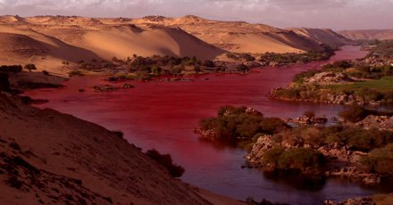
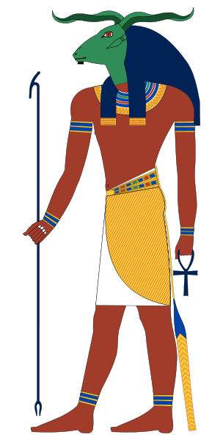
“…In the sight of Pharaoh and in the sigh of his servants he lifted up the staff and struck the water in the Nile, an d all the water in the Nile turned into blood. And the fish in the Nile died, and the Nile stank, so that the Egyptians could not drink water from the Nile. There was blood throughout all the land of Egypt. (Exodus 7:20-21)

Slide 6
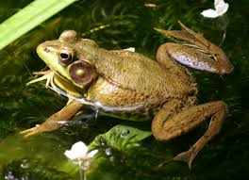
“…frogs shall come up into your house and into your bedroom and on your bed and into the houses of your servants and your people, and into your ovens and your kneading bowls. The frogs shall come up on you and on your people and on all your servants. (Exodus 8:3-4)

Slide 7
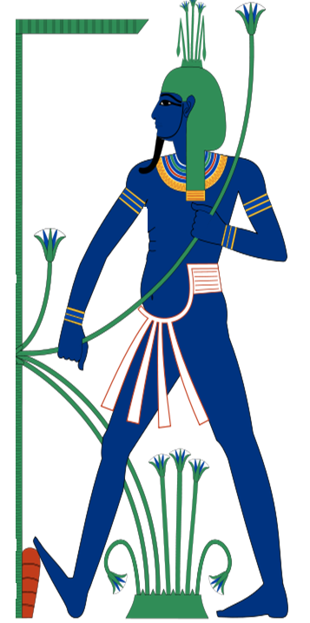
“…frogs shall come up into your house and into your bedroom and on your bed and into the houses of your servants and your people, and into your ovens and your kneading bowls. The frogs shall come up on you and on your people and on all your servants. (Exodus 8:3-4)
“…the frogs died out in the houses, the courtyards, and the fields. And they gathered them together in heaps, and the land stank.” (Exodus 8:13-14)

Slide 8
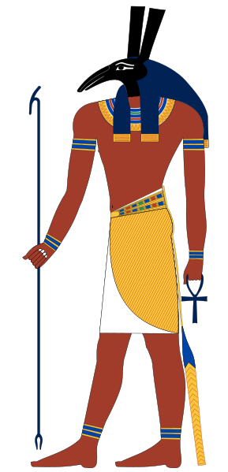
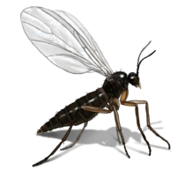
“…Aaron stretched out his hand with his staff and struck the dust of the earth, and there were gnats on man and beast. All the dust of the earth became gnats in all the land of Egypt.”
(Exodus 8:17)
“This is the finger of God.” (Exo. 8:19)

Slide 9
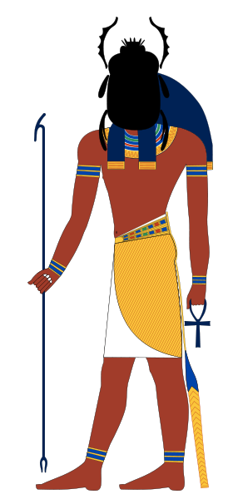
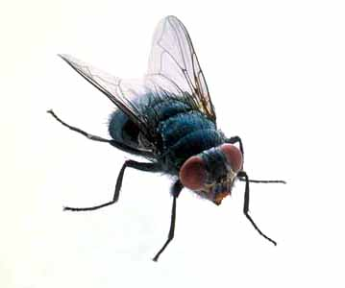
“…swarms of flies on you and your servants and your people, and into your houses. And the houses of the Egyptians will be filled with swarms of flies, and also the ground on which they stand…throughout all the land of Egypt the land was ruined by the swarms of flies.” (Exodus 8:21,24)

Slide 10
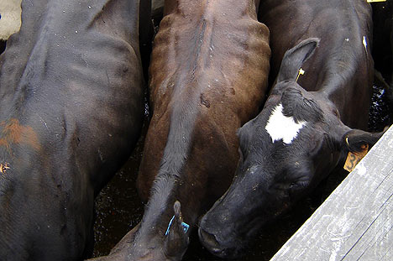
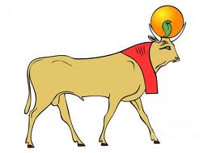
“…a severe plague upon your livestock that are in the field, the horses, the donkeys, the camels, the herds, and the flocks…all the livestock of the Egyptians died, but not one of the livestock of the people of Israel died.” (Exodus 9:3, 6)

Slide 11
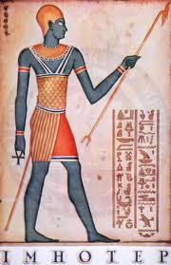
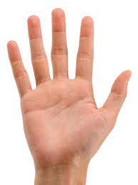
“So they took soot from the kiln and stood before Pharaoh. And Moses threw it in the air, and it became boils breaking out in sores on man and beast. And the magicians could not stand before Moses because of the boils, for the boils came upon the magicians and upon all the Egyptians.” (Exodus 9:10-11)

Slide 12
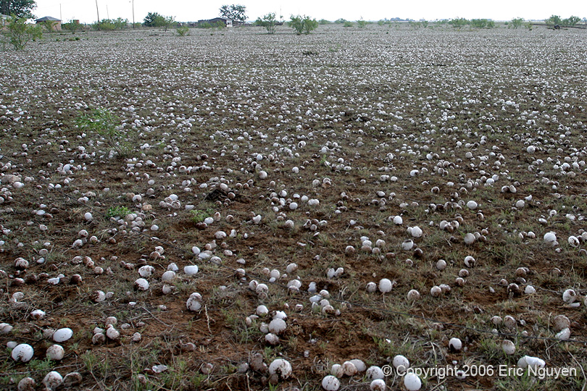
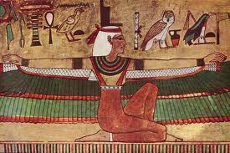
“There was hail and fire flashing continually in the midst of the hail, very heavy hail, such as had never been in all the land of Egypt since it became a nation. The hail struck down everything that was in the field in all the land of Egypt, both man and beast. And the hail struck down every plant of the field and broke every tree of the field.”
(Exodus 9:10-11)

Slide 13
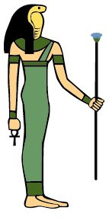
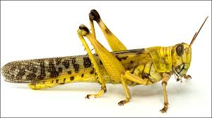
“The locusts came up over all the land of Egypt and settled on the whole country of Egypt, such a dense swarm of locusts as had never been before, nor ever will be again. They covered the face of the whole land, so that the land was darkened, and they ate all the plants in the land and all the fruit of the trees that the hail had left. Not a green thing remained, neither tree nor plant of the field, through all the land of Egypt.”
(Exodus 10:14-15)

Slide 14
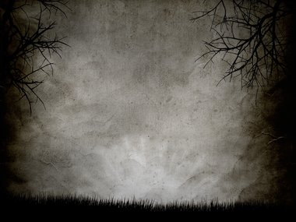
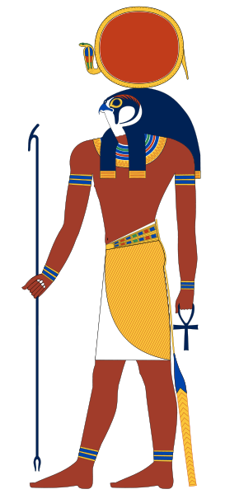
“…darkness over the land of Egypt, a darkness to be felt. So Moses stretched out his hand toward heaven, and there was pitch darkness in all the land of Egypt three days. They did not see one another, nor did anyone rise from his place for tree days, but all the people of Israel had light where they lived.”
(Exodus 10:21-22)

Slide 15
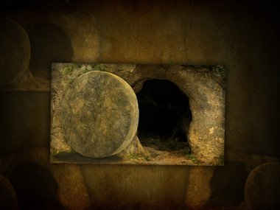
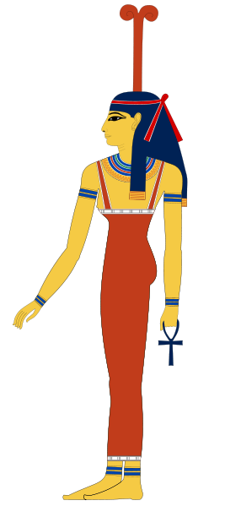
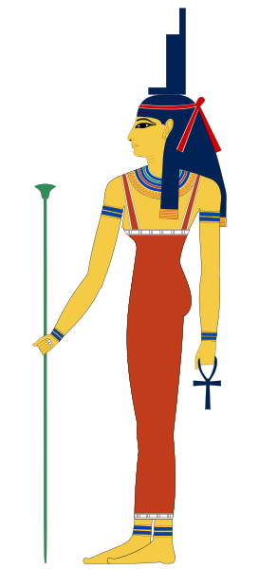
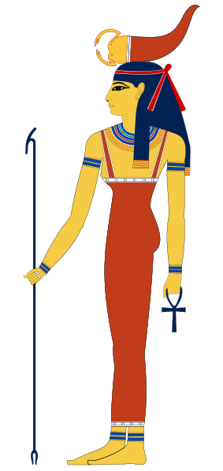
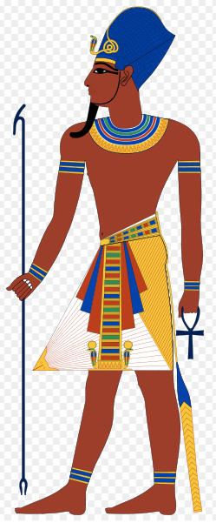
“At midnight the Lord struck down all the firstborn in the land of Egypt, from the firstborn of Pharaoh who sat on his throne to the firstborn of the captive who was in the dungeon, and all the firstborn of the livestock. And Pharaoh rose up in the night, he and all his servants and all the Egyptians. And there was a great cry in Egypt, for there was not a house where someone was not dead.”
(Exodus 10:21-22)

Slide 16
“For I will pass through the land of Egypt that night, and I will strike all the firstborn in the land of Egypt, both man and beast; and on all the gods of Egypt I will execute judgments: I am the Lord.”
(Exodus 12:12)

Slide 17
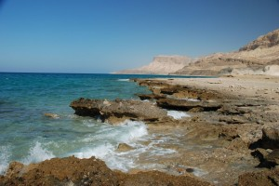
“Thus the Lord saved Israel that day from the hand of the Egyptians…”
(Exodus 14:30-31)

Slide 18
He Wanted Them To Understand…
"I am the LORD your God, who brought you out of the land of Egypt, out of the house of slavery. "You shall have no other gods before me. "You shall not make for yourself a carved image, or any likeness of anything that is in heaven above, or that is in the earth beneath, or that is in the water under the earth. You shall not bow down to them or serve them, for I the LORD your God am a jealous God…(Exodus 20:2-5)

Slide 19
He Wanted Them To Understand…
The People Forget
Judges 2:10
1 Kings 11
The Folly of Idols
Isaiah 44:6-8
Isaiah 45:5-6, 18-22

Slide 20
He Wants Us To Understand…
1 Corinthians 10:1-14
Galatians 5:19-21
Colossians 3:5-6
1 John 5:21
Matthew 6:33
We too must not forget

Slide 21
Have NO Other Gods

